Slide 2

Relational Data Model
Introduced by Codd in 1970
Most DBMS are based on this model
Represents the database as a collection of relations.
Each relation is a table: a table is a set of rows, where each row in the table represents a collection of related data values

Slide 3
First let’s learn some terminology

Slide 4
A Domain D is a set of atomic values, Example: USA_Phone_Numbers, Employee_Ages, Department IDs
Set of 10 digit phone numbers valid in Canada
Possible ages of employees
A data type is specified for each domain like 10 char string or positive integer
A Relation Schema R denoted by R(A1, A2, ...An) is made up of a relation name and a list of attributes. Each attribute Aj is the name of a role played by some domain D in the relation schema R.
R is called the name of the relation
Attribute is a named column in a relation
Tuple is a row of a relation
Degree of a relation is the number of attributes it contains
Cardinality of a relation is the number of tuples it contains

Slide 5
A relation (or relation state)
r of a relation schema R(A1, A2, .... An) also denoted by r(R) is a set of n-tuples r = {t1, t2, ... tm}. Each n-tuple t is an order list of n values t=< v1, v2, ... ______> , where each value vi, 1<=i<=n, is an element of dom(Ai) or a special null value.
Mathematical Relations:
Suppose we have 2 set D1 = {2,4} and D2 = {1,3,5}. The Cartesian product D1 X D2 represents all possible ordered pairs:
{(2,1), (2,3), (2,5), (4,1), (4,3), (4,5)} Any subset of D1 X D2 represents a relation --> R = {(2,5), (4,1)}
We could have three sets: D1, D2 and D3 and build a relation on D1 X D2 X D3, in general we write:

Slide 6
QUESTION: If we have:
D1= {Simpson, Flanders, Smithers}
D2 = {Homer, Ned}
D3 = {40,30}
What would D1 X D2 X D3 give us:

Slide 7
Properties of Relations:
Each relation name is
Each cell in a relation contains 1 atomic value (Normalized, First Normal Form)
Each attribute name within a table is
The values of an attribute are from the same domain
The order of the attributes has no significance
Each tuple is distinct (no duplicates)
The order of the tuples has no significance (Tuples in a relation do not have any particular order, however in a file records are physically stored on disk so there is always an order among records. Note: we may chose to display the records in a particular order)
Notes:
Unique
Unique

Slide 8
MOST OF THE ABOVE PROPERTIES ARE FROM MATHEMATICAL RELATIONS
Since a relation is a set, the order doesn't matter, therefore the order of the tuples doesn't matter.
In a set, no elements are repeated, therefore tuples are unique
Mathematical Relations are not necessarily normalized (reduced redundancy) however Codd chose Relations to be.
In a relation, possible values for a given position are determined by the set or domain on which the position is defined, thus in a table the values in a column must come from the same domain.

Slide 9
Example:
Attribute: (there are 5 attributes in this table)
Relation (or Table)
Employee
SSN | FirstName | LastName | Department | Position
123 | Laura | Reid | Computer Science | Lecturer
005 | Bob | Bryan | Math | Professor
125 | Sylvia | Osborn | Computer Science | Professor
137 | Bob | Bryan | Math | Professor
Key (each tuple must be different)
Tuple (there are 4 tuples in this table)
Domain Sample Domain: domain of SSN is 000 to 999 in this table

Slide 10
Relational Constraints
Keys and Key Constraints
Keys → used to enforce that no 2 tuples can be identical
QUESTION: What is the key of this table?
SSN | LastName | FirstName
34 | Simpson | Homer
56 | Simpson | Marge
78 | Smithers | Marge
99 | Simpson | Homer

Slide 11
QUESTION: How about this table?
LastName | FirstName
Simpson | Homer
Simpson | Marge
Smithers | Marge
 | Homer
Simpson
Smithers
QUESTION: What if we changed the last record to have a last name of Smithers rather than Simpson, then what could be a key in this particular snapshot of the database? (although, not a good one!)

Slide 12
QUESTION: How about this table?
Attribute1 | Attribute2 | Attribute3
a1 | b1 | c1
a1 | b2 | c1
a2 | b1 | c2
a2 | b2 | c2

Slide 13
SuperKey: any set of attributes that enforce that no tuples are alike
Candidate Key: sometimes a table will have 2 possible things that could be keys (e.g. employee number and SSN, each of them is a candidate key ) also must be a superkey such that proper subset is a superkey within the relation. Candidate key is a “minimal superkey” QUESTION: Give an example of a set of attributes that is a superkey for the previous table above but not a candidate key:
Primary Key: Pick one candidate key to identify tuples in the relation (signify this key by underling it)
Foreign Key: An attribute or set of attributes within one relation that matches the candidate key of some other (possibly the same) relation

Slide 14
QUESTION: What is the foreign key in this situation:
Department
DeptID | DeptName | MgrEmpID | MgrStartDate
11 | CompSci | 003 | 12/12/99
22 | Math | 124 | 11/11/98
…
Employee
EmpID | LastName | FirstName | DeptID | Sex
003 | Bauer | Mike | 11 | M
122 | Reid | Laura | 11 | F
…

Slide 15
For the following table:
QUESTION: Give 3 Superkeys
QUESTION: Give 2 Candidate Keys
QUESTION: Give 1 Primary Key
LicenseNum | EngineSerialNum | Make | Model | Year
Ont ABBC 123 | AB12 | Ford | Jeep | 96
Ont XED 444 | CD11 | Olds | LaSabre | 98
Que ABC 123 | AE12 | Ford | Mustang | 98
Que ABD 111 | AE23 | Olds | Cutlass | 96
Ont ABCD 111 | SE12 | Honda | Civic | 95
NS ABC 22 | SE67 | Ford | Mustang | 98

Slide 16
Key Constraints
Keys must be unique
Primary Key must be NON NULL (Also called the Entity Integrity Constraint)
Most DBMS enforce both of the above constraints
Both of the above constraints (and domain constraints) are on individual tables (just one table).
The upcoming constraints (in the next topic) are on relationships between tables.

Slide 17

Now, let’s see/figure out the BEAUTY of the relational model!

Slide 18
Think about going from: → The Real World (a mini universe) TO A … →Model (ER Diagram) TO A … →Relational Database
Our only real rule is that: We can only use these data structures:
Tables
Rows
Columns
Cells

Slide 19
Representing ER Entities in the Relational Model
How do we represent entities such as Professor or Department?
First
PROFESSOR
Name
Office
EmplD
Last
Ext

Slide 20
Ta Da….
First
PROFESSOR
Name
Office
Last
Ext
EmplD
Becomes this…
FirstName | LastName | EmpID | Office | Ext
Laura | Reid | 11 | ST238 | 86905
Doug | Vancise | 22 | MC 421 | 83355
Michael | Atkinson | 15 | SSC 44 | 83456
Stuart | Rankin | 18 | MC 101 | 87678
Jamie | Andrews | 34 | MC 343 | 86789
Irving | Robinson | 56 | MC 102 | 86733

Slide 21
Representing Relationships Using ONLY Tables
Suppose you have the following 2 tables: Professor and Department:
FirstName | LastName | EmpID | Office | Ext
Laura | Reid | 11 | ST238 | 86905
Doug | Vancise | 22 | MC 421 | 83355
Michael | Atkinson | 15 | SSC 44 | 83456
Stuart | Rankin | 18 | MC 101 | 87678
Jamie | Andrews | 34 | MC 343 | 86789
Irving | Robinson | 56 | MC 102 | 86733
DeptID | DeptName | Building
MA | Math | Middlesex College
CS | Computer Science | Middlesex College
PS | Psychology | Social Science Centre

Slide 22
We want to show the following relationship as a table:
Works for
M
1
Professor
Department
QUESTION: How could you model this relationship using only tables (rows or columns)
The Rules are:
1. YOU CAN ADD AS MANY NEW COLUMNS AND ROWS AS YOU WANT TO THE EXISTING TABLES
2 . AND IF YOU NEED A NEW TABLE YOU CAN ADD THAT ALSO,
3. BUT THAT IS ALL YOU CAN ADD → COLUMNS, ROWS and TABLES

Slide 23
QUESTION: What is the primary key of table PROFESSOR? ___________, foreign key(s) ___________
What is the primary key of table DEPARTMENT? _______, foreign keys(s) ________________

Slide 24
We want to show the following additional relationship:
M
1
Professor
WorksFor
Department
1
1
Chairs
QUESTION: How could you model the Chairs relationship using only tables (rows or columns)

Slide 25
QUESTION: What is the primary key of table PROFESSOR? ___________, foreign key(s) ___________
What is the primary key of table DEPARTMENT? _______, foreign keys(s) ________________

Slide 26
Suppose now we add the following table:
CourseNumber | CourseName
CS3319 | Intro to Databases
CS2210 | Data Structures and Algorithms
CS1027 | Computer Science Fundamentals II
MA2222 | Discrete Structures
And we have the following relationship:
M
N
Professor
Teaches
Course

Slide 27
QUESTION: How could you model this relationship using only tables (rows or columns)?
QUESTION: What is the primary key? What is the foreign key(s)?

Slide 28
Mapping ER Diagrams To Relational Databases
Step 1: For each regular entity type E in the ER schema, create a relation R that includes all simple attributes of E. Include only the simple component attributes of a composite attribute. Choose one of the key attributes of E as primary key for R. If the chosen key of E is composite, the set of simple attributes that form it will together form the primary key of R.
Step 2: For each weak entity type W in the ER schema with owner entity type E, create a relation R, and include all simple attributes (or simple components of composite attributes) of W as attributes of R. In addition, include as foreign key attributes of R the primary key attribute(s) of the relation(s) that correspond to the owner entity type(s); The primary key of R is the combination of the primary key(s) of the owner(s) and the partial key of the weak entity type W, if any.

Slide 29
Step 3: For each binary 1:1 relationship type R in the ER schema, identify the relations S and T that correspond to the entity types participating in R. Choose one of the relations S, say and include as foreign key in S the primary key of T. It is better to choose an entity type with total participation in R in the role of S. Include all the simple attributes (or simple components of composite attributes) of the 1:1 relationship type R as attributes of S.
Step 4: For each regular (non weak) binary 1:N relationship type R, identify the relation S that represents the participating entity type at the N-side of the relationship type. Include as foreign key in S the primary key of the relation T that represents the other entity type participating in R; this is because each entity instance on the N-side is related to at most one entity instance on the 1-side of the relationship type. Include any simple attributes (or simple components of composite attributes) of the 1:N relationship type as attributes of S.

Slide 30
Step 5: For each binary M:N relationship type R,create a new relation S to represent R. Include as foreign key in S the primary keys of the relations that represent the participating entity types; their combination will form the primary key of S. Also include any simple attributes (or simple components of composite attributes) of the M:N relationship type as attributes of S.
Step 6: For each multivalued attribute A, create a new relation R that includes an attribute corresponding to A plus the primary key attribute K (as a foreign key in R) of the relation that represents the entity type or relationship type that has A as an attribute. The primary key of R is the combination of A and K. IF the multivalued attribute is composite, we include the simple components.

Slide 31
Step 7: For each n-ary relationship type R, n > 2, create a new relation S to represent R. Include as foreign key in S the primary keys of the relations that represent the participating entity types; their combination will form the primary key of S. Also include any simple attributes (or simple components of composite attributes) of the n-ary relationship type as attributes of S.
rattr
cc
aa
rr
Table rr
cid
bb
aid * | bid * | cid * | rattr
aid
bid

Slide 32
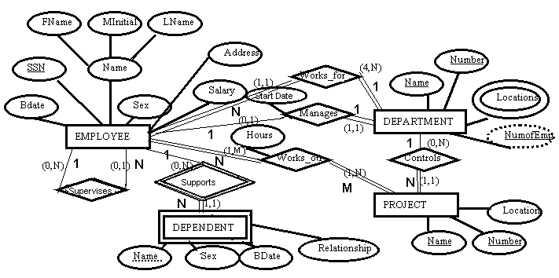
Our Company Example:

Slide 33
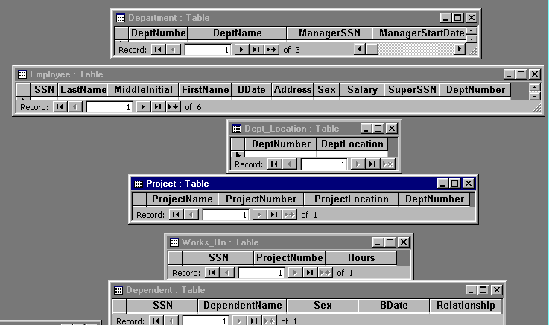
Our Example Mapped to Relations (Tables):
In the above example, I mapped our example to an MS Access Database

Slide 34
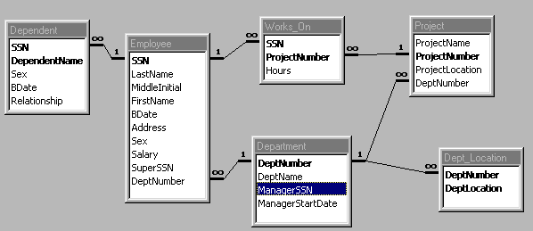

Slide 35
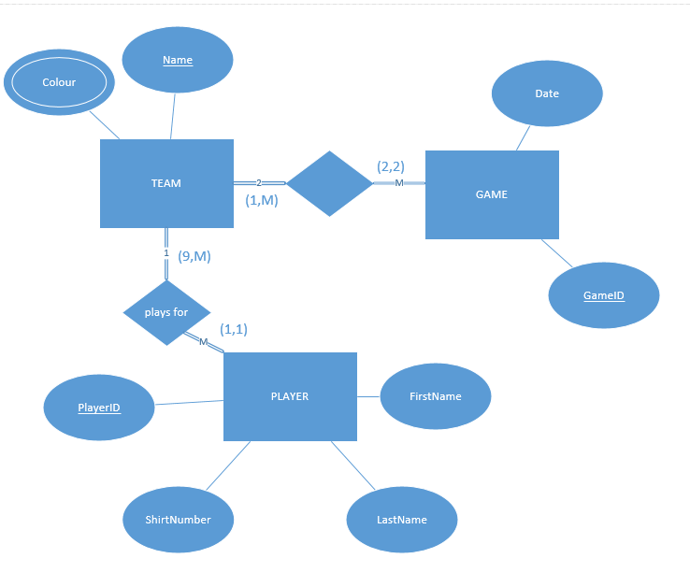
Take the example from slide 1 and map it to a relational database
score

Slide 36
Referential Integrity
Referential Integrity: a tuple in one relation that refers to another relation must refer to an existing tuple in the relation.
Formally:
Assume we have R1 and R2 with a referential integrity between the two of them. R1 has a set of attributes FK (foreign key) that references the attributes PK (primary key) R2, it must satisfy the following rules:
FK attributes must have the same domain as PK
a value of FK in a tuple t of the current state r1(R1) either occurs as a value of PK for some tuple t2 in the current state or r2(R2) is null.

Slide 37
Update Operations on Relations maintaining Integrity Rules
Department
DeptID | DeptName | MgrEmpID | MgrStartDate
G8H | Head Office | 4 | 12/12/99
S7G | Safety Department | 3 | 11/11/98
Y5J | Research Department | 6 | 12/24/98
Employee
EmpID | LastName | FirstName | DeptID | Sex
1 | Simpson | Bart | S7G | M
2 | Smithers | Waylan | G8H | M
4 | Burns | Monty | G8H | M
6 | Simpson | Lisa | Y5J | F
3 | Beuvieau | Patty | S7G | M
12 | Simpson | Homer | S7G | M

Slide 38
QUESTION: Determine the problems (if any exist) with the following operations to the above tables?
Insert Operation Problem?
Insert <13, 'Gumble', 'Barney', 'S7G', 'Male'> into EMPLOYEE Yes No Insert <3,'Simpson', 'Granpa', 'Y5J', 'Male'> into EMPLOYEE Yes No Insert <NULL, 'Flanders', 'Ned', 'Y5J', 'Male'> into EMPLOYEE Yes No Insert <18, 'Flanders', 'Todd', 'P68', 'Male'> into EMPLOYEE Yes No
Department
DeptID | DeptName | MgrEmpID | MgrStartDate
G8H | Head Office | 4 | 12/12/99
S7G | Safety Department | 3 | 11/11/98
Y5J | Research Department | 6 | 12/24/98
Employee
EmpID | LastName | FirstName | DeptID | Sex
1 | Simpson | Bart | S7G | M
2 | Smithers | Waylan | G8H | M
4 | Burns | Monty | G8H | M
6 | Simpson | Lisa | Y5J | F
3 | Beuvieau | Patty | S7G | M
12 | Simpson | Homer | S7G | M

Slide 39
Delete Operation Problem
Delete employee where EmpID = 4 Yes No Delete department where DeptID = 'S7G' Yes No
Department
DeptID | DeptName | MgrEmpID | MgrStartDate
G8H | Head Office | 4 | 12/12/99
S7G | Safety Department | 3 | 11/11/98
Y5J | Research Department | 6 | 12/24/98
Employee
EmpID | LastName | FirstName | DeptID | Sex
1 | Simpson | Bart | S7G | M
2 | Smithers | Waylan | G8H | M
4 | Burns | Monty | G8H | M
6 | Simpson | Lisa | Y5J | F
3 | Beuvieau | Patty | S7G | M
12 | Simpson | Homer | S7G | M
QUESTION: DB2 allows 3 things to happen if you set up referential integrity between keys when you perform a delete, DB2 allows for:
Cascade
Restrict
Set Null
What do you think each of these operations do?

Slide 40
Modify Operation:
Modify the sex of Employee where lastname = 'Smithers' to Female Modify Employee where lastname = 'Smithers' from DeptID = 'G8H' to DeptID = 'Y5J' Modify Employee where lastname = 'Smithers' from DeptID = 'G8H' to DeptID = 'J9J' Modify Employee where lastname = 'Smithers' from EmpID = 2 to EmpID = 12
Problem:
Yes No
Yes No
Yes No
Yes No
Department
DeptID | DeptName | MgrEmpID | MgrStartDate
G8H | Head Office | 4 | 12/12/99
S7G | Safety Department | 3 | 11/11/98
Y5J | Research Department | 6 | 12/24/98
Employee
EmpID | LastName | FirstName | DeptID | Sex
1 | Simpson | Bart | S7G | M
2 | Smithers | Waylan | G8H | M
4 | Burns | Monty | G8H | M
6 | Simpson | Lisa | Y5J | F
3 | Beuvieau | Patty | S7G | M
12 | Simpson | Homer | S7G | M

Slide 41
Semantic Integrity Constraints
State Constraints: state the constraints that a valid state of the database must satisfy
Example: Hours worked cannot be greater than 50, Quantity Ordered must be greater than 10
Transition Constraints: define how the state of the database can change
Example: Salaries can only increase
Both of the above are enforce in SQL through triggers and assertions

Slide 42
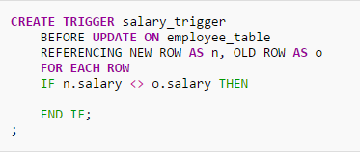
Example of a trigger
Triggers are on inserts, updates or deletes. Can you figure out what this one does?

Slide 43
http://www.youtube.com/watch?v=iKK3P11OCyM

Slide 44
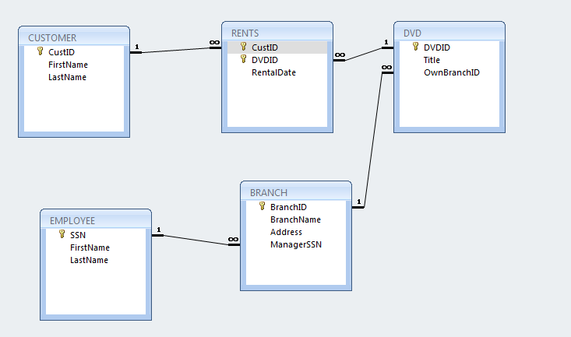
QUESTION: Assume you have the following ER diagram, map it to the appropriate tables:
DVDID
FirstName
LastName
Title
N
DVD
CusID
M
Rents
Customer
N
Belongs to
DateRented
1
Address
SSN
1
1
Branch
Manages
Employee
FirstName
BranchName
LastName
BranchID

